Slide 1

Estimated House Prices in Northampton, Massachusetts

Slide 2
Agenda
Introduction
Data Overview
Response Variable Review
Preliminary Model Investigation
Variable Summaries
Model 2 Summary
Conclusion
Model Validation

Slide 3
Introduction
A group of industry professionals are interested in determining if the proximity to the Rail Trail systems impacts the value of a home.
Homes usually have common explanatory variables used for price estimation such as number of bedrooms, bathrooms, lot size (acre), year built and current condition.
Homeowners can make changes to these variables by addition or updating features within the house whereas distance to Rail Trail system is a non-mutable option.

Slide 4
Data
The data set includes 104 observations with 26 variables describing house characteristics.
There are 5 qualitative and 21 quantitative variables which we will use to predict the quantitative response/dependent variable.
Our response variable is Price 2014 (Zillow Price Estimate) We used the available data from the set to model this response

Slide 5
Response Variable
Given the data set was collected from home sales in 2007, the goal of this analysis was to use current price estimates which requires modeling to 2014 estimate house prices.
First, we check for completeness via missing values
Next, we visualize the data to check for normality
We can see the distribution is right skewed with a possible outlier.

Slide 6
Preliminary Model Investigation
Variables Zillow uses in its own home price estimate algorithm.
Square feet, distance, number of rooms, number of full and half baths.
Model 1: E(y) = β0 + β1x1 + β2x2 + β3x3 + β4x4 + β5x5
Correlation matrix showed that these variables do have a linear relationship with the response variable.

Slide 7
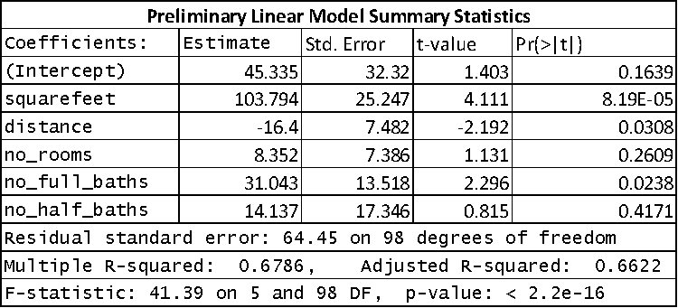
Model 1 Performance

Slide 8
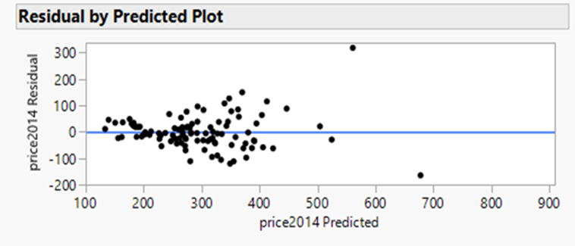
Model Summary
Only Square Feet, distance and number of full bathrooms were significant in the model.
Residual analysis (residual plot) indicating transformations are required as assumptions such as normality of residuals and constant variance of residuals were violated.

Slide 9
Transformation selection
We tried three methods of transformation of Price 2014, square root, natural log and reciprocal.
Out of the 3 transformations we selected the natural log as giving us the best normality feature in our response variable.
We still saw potential for an outlier in our data and kept that in mind as we investigated further
We also considered log transformation of number of rooms.

Slide 10
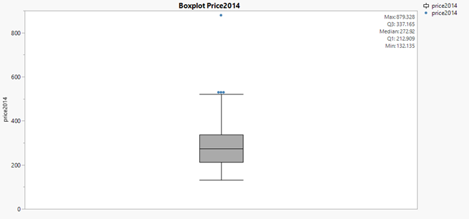
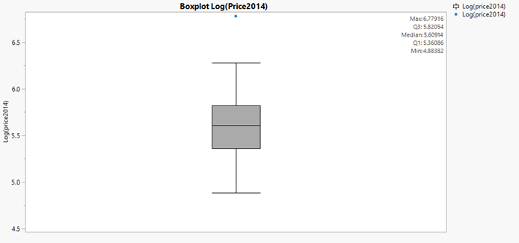
Boxplots of Price 2014
With the transformation we can see a reduction of outliers when comparing non-transformed to transformed response.

Slide 11
Variable Summary
Variables | Max | Min | Median | Mean | Std Dev
Log Price2014 ($1000) | 2.94 | 2.12 | 2.44 | 2.44 | 0.33
Distance(miles) | 3.98 | 0.04 | 0.76 | 1.11 | 0.94
Log Number of Room | 1.15 | 0.60 | 0.81 | 0.81 | 0.24
Number Bathrooms | 4 | 1 | 1.5 | 1.6 | 0.62
Lot Utilization | 23.34 | 1.45 | 6.94 | 8.00 | 4.84
Garage Spaces | 4 | 0 | 1.0 | 0.76 | 0.86
We sought to incorporate two variables number of full and half baths into one variable in effort to aide our analysis.
We also added lot utilization as a predictor variable given by (acreage*43.56) / square feet.
Here is a summary statistic table of our variables selected for the second model.

Slide 12
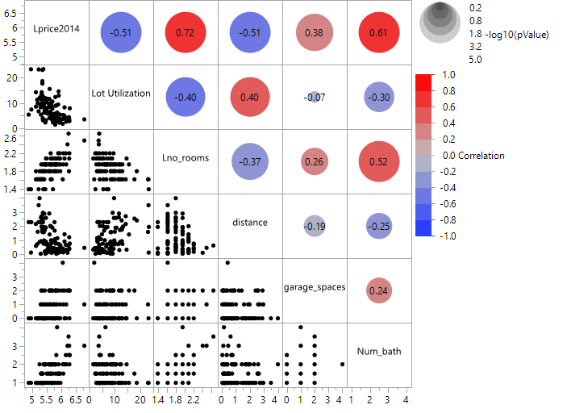
Correlation Matrix

Slide 13
Model 2 Summary
Model 2: E(log(y)) = β0 + β1x1 + β2log(x2) + β3x3 + β4x4 + β5x5
All predictor variables were found to be significant.
Adjusted R Square 0.688
Residual Standard Error 0.1865

Slide 14
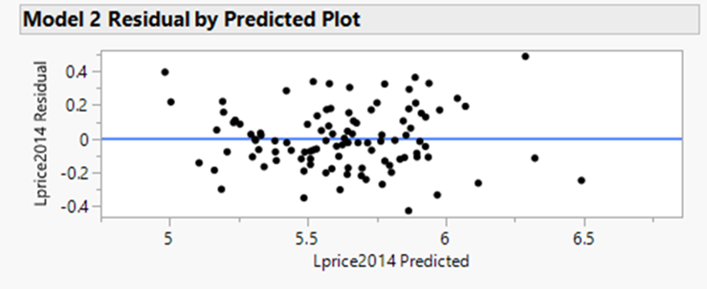
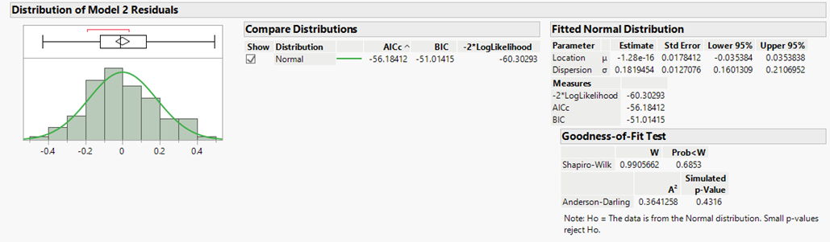
Model 2 Validation
Residual plot shows improvement heteroscedasticity.
Breusch-Pagan test produced a p-value of 0.12 failing to reject H0, error variances are equal.
Shapiro-Wilk & Anderson Darling Test conclude approximate normal distribution of the residuals.

Slide 15
Model Comparison
PRESS Criteria preferred Model 1
AICc, R²_{adj,} and RMSE Model 2 performed better.
Model 2 met the regression assumptions, which indicates Model 2 results are more reliable.
Model 2 will be selected given it passed regression assumptions.
Model # | AICc | R²_{adj} | PRESS | RMSE
1 | 1170.62 | 0.66 | 0.61 | 64.45
2 | -45.14 | 0.69 | 0.66 | 0.19

Slide 16
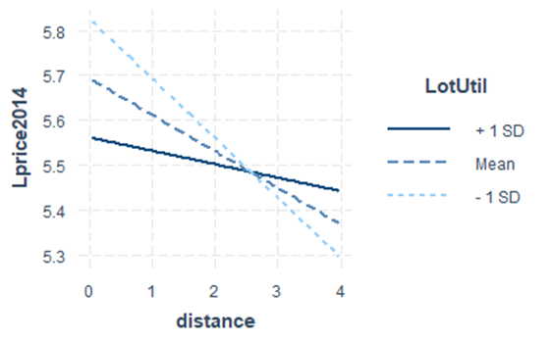
Investigation of Model 2 Interactions
Interaction plot shows that properties with higher lot utilizations, generally have lower home prices.
This appears counterintuitive, as with bigger property you wouldn't expect lower home value.
Addition of this interaction term violated the regression assumptions of normality and homoscedasticity in the model.
We concluded to leave this term out.

Slide 17
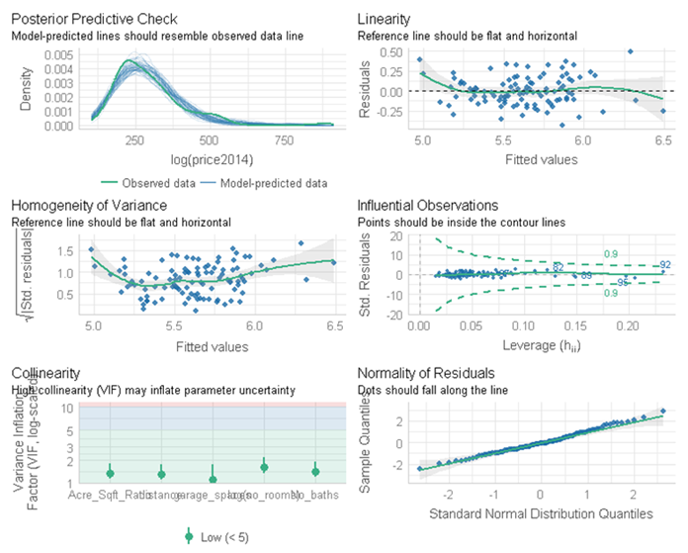
Model Validation
VIF scores were all below 2, indicating no high correlation between predictor variables.
Cook’s distance plot showed all residuals fell within the lines, indicating no extreme influential data points present.
Standard distribution quantiles plot infers the error term is normally distributed.

Slide 18
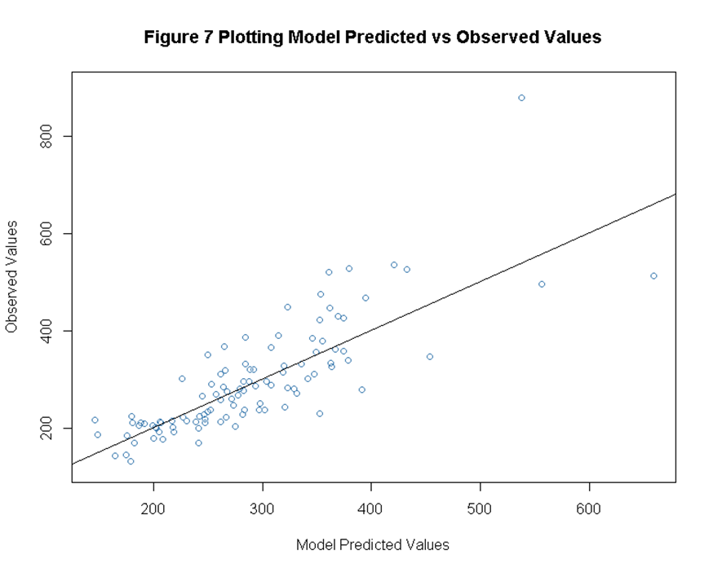
Coefficient Interpretation & Model Fit
X1 distance we expect a decrease in home valuation of 6.53% for every one-unit increase in X1.
X2 log number of rooms we expect an increase in home valuation of 25.24% for every 50% increase in number of rooms.
X3 garage spaces we expect an increase in home valuation of 6.22% for every one-unit increase in X3.
X4 number of baths we expect an increase in home valuation of 15.26% for every one-unit increase in X4.
X5 lot utilization we expect a decrease of 1.26% for every one-unit increase in X5.
Observed values fall closely to the regression line.

Slide 19
Conclusion
Established statistically significant variables for modeling the response price 2014.
Modeling showed distance has effect on home valuation, decrease of 6.5% for every one unit increase of distance.
This information can aid professionals within the real estate industry as well as consumers interested in the Northampton community.
Important to note, other variables not in the data set could be informative to the model and effect future performance.

